Slide 1



Automation Platinum Demo
Managing and securing enterprise content at scale
Introduction and overview

Slide 2
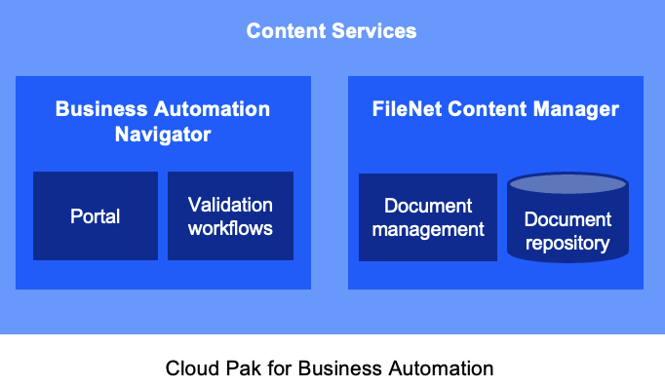
Demo overview
REMOVE THIS SLIDE BEFORE PRESENTING TO CUSTOMERS
Purpose of this deck | This deck is to be shown to customers to introduce and summarize the Managing and securing enterprise content at scale Platinum demo.
Scenario overview | The demo uses a hiring process example to illustrate how the Cloud Pak for Business Automation provides advanced document management capabilities and built-in approval workflows.
Product(s) in the demo | Cloud Pak for Business Automation
Capabilities to be demonstrated | FileNet Content Manager; Business Automation Navigator
Supported product version(s) | Cloud Pak for Business Automation 23.0.1
IBM Technology Zone page | https://techzone.ibm.com/collection/managing-and-securing-enterprise-content-at-scale
Demo Components
IBM TechZone-provided environment

Slide 3
Demo overview
Scenario
John Doe applies for an open position in the R&D department at Focus Corp.
The human resources department creates a teamspace to share and collaborate on hiring. Documents are stored in a secure repository, and redactions are added to restrict access to private information.
The hiring manager reviews the candidate’s documents to prepare for the interview. She gets all the hiring forms from a shared teamspace. She accesses, reviews and annotates the candidate documents within the teamspace. After the interview, she adds an evaluation form for salary determination.
Each team member proposes an appropriate salary based on their criteria and budget limits. The HR manager merges the salary information into a summary document to be reviewed and approved by all stakeholders.
Cloud Pak capabilities in the demo
FileNet Content Manager /
Business Automation Navigator

Slide 4
Demo flow
Introduction
Create teamspace
Redact data
A candidate has applied for an open position and has sent application documents
Create a teamspace to share documents across the team
Use redactions to hide personal data
Approve document
Collaborate across the team
Use the built-in process to approve the merged salary document
Add and update documents within the teamspace. Merge documents to make reviews easier.

Slide 5
Demo components
Content services
Business Automation Navigator
FileNet Content Manager
Portal
Validation workflows
Document management
Document repository
Cloud Pak for Business Automation

Slide 6
DEMO
Managing and securing
enterprise content at scale

Slide 7
Key takeaways
Managing and securing enterprise content at scale
Centralized, easy-to-use Enterprise Content Management…
provides a pre-configured, collaborative content management environment
enforces document security and traceability
simplifies document review across teams, improving productivity
Teamspaces provide pre-configured and pre-populated document sharing environments. This enhances collaboration while minimizing risk through fine-grained security and access restriction settings.
Role-based redaction uses advanced policies to conceal sensitive or confidential data based on business needs and regulatory requirements.
Out-of-the-box approval processes can be initiated with a single click and track parallel or sequential document approvals.
Notes:
auses

Slide 9
Additional learning resources
IBM Cloud Pak for Business Automation
Learn more about the features highlighted in the demonstration:
Configuring teamspaces
Using role-based redaction
Adding document annotations
Working with parallel or sequential workflows

Slide 10

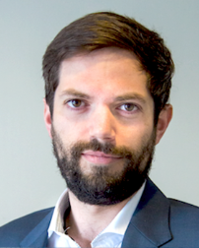



Personas in the demo
Debby Focus Corp Hiring Manager
Selects hiring candidates
Teamspace
John Doe External Candidate
Applies for a job at Focus Corp
Henry Focus Corp HR Manager
Leads the hiring process
Patrick Focus Corp Payroll Manager
Approves the salary budget

